Slide 1
Physics Problem Solving
Mar. 4th Mon 12:40 – 13:20
Physics Lab P2
Eason Shao

Slide 2
Quick Intro

Slide 3

About Physics PS
BPhO Challenges - https://www.bpho.org.uk
Y11Intermediate Phys. C – 1hr; Mar 1st
Y12 Senior Phys. C – 1hr; Mar 8th
Y13 Phys. C – 1hr; Sept - Nov
BPhO R1 – 2hr 40min; Nov
BPhO R2 (Inv. Only) – 3hr; Feb
Uni Admission Tests

Slide 4
Today
Selected Question from Y12 Senior Phys. Challenge

Slide 5
Some things before we start
Think – do not give up before you think. Nor should you search up solutions before you begin.
No Hints – if you finish, raise your hand, and we will come and check your solution. Please remain quiet as other people need the chance to think.
Be a Scientist – do not make assumptions or arguments without a justification, nor should you argue that it is obvious if you can’t explain it.
Don’t Worry if you Make Mistakes – it’s problem-solving, not trivial questions. And everybody makes mistakes.

Slide 6
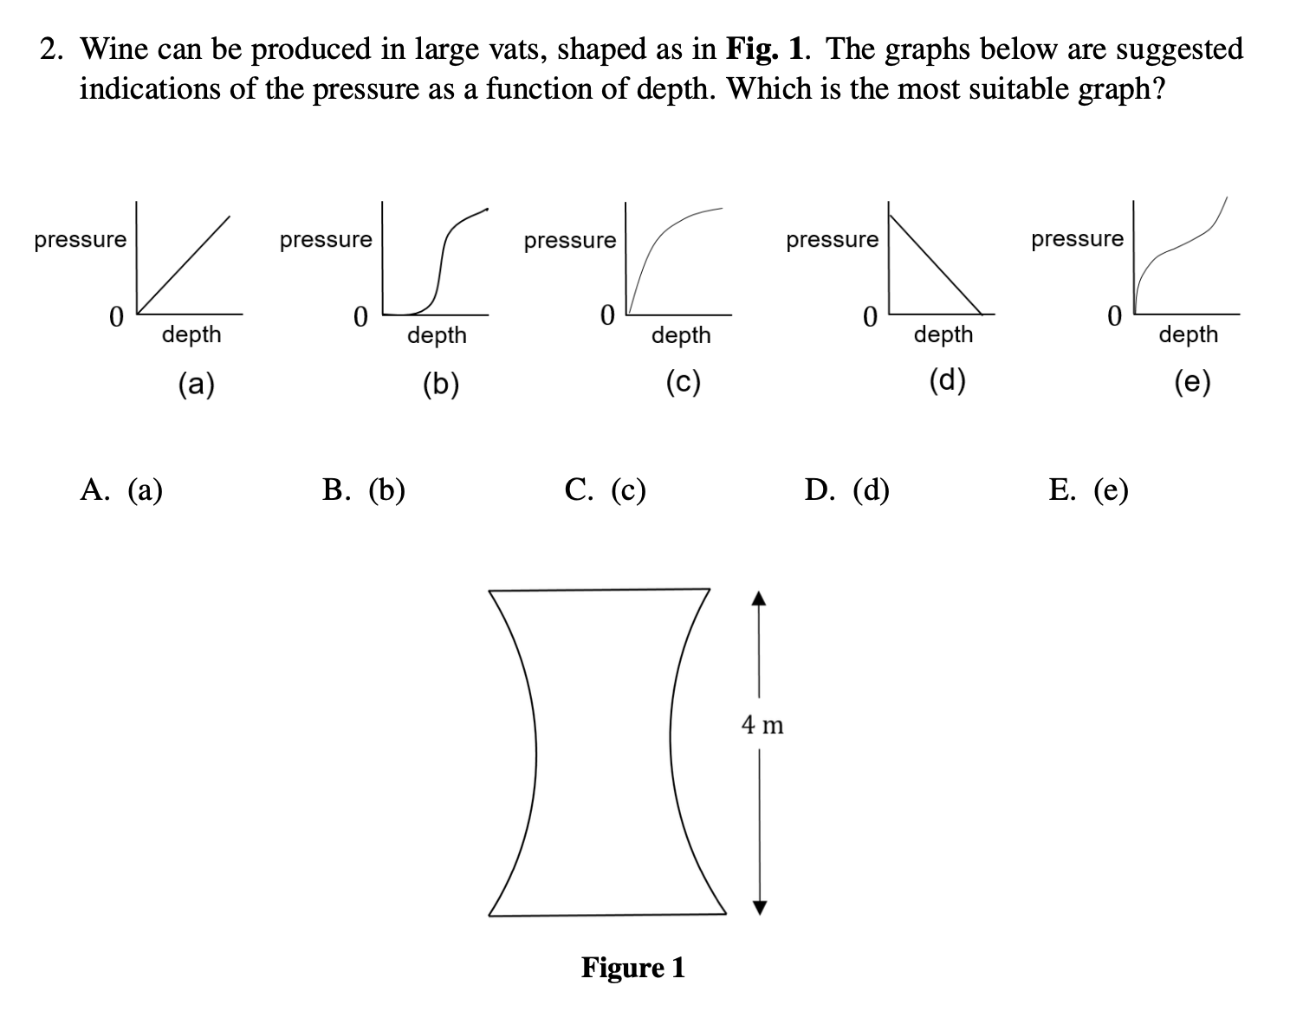
Qu. 1 (Time: 45 sec)

Slide 7
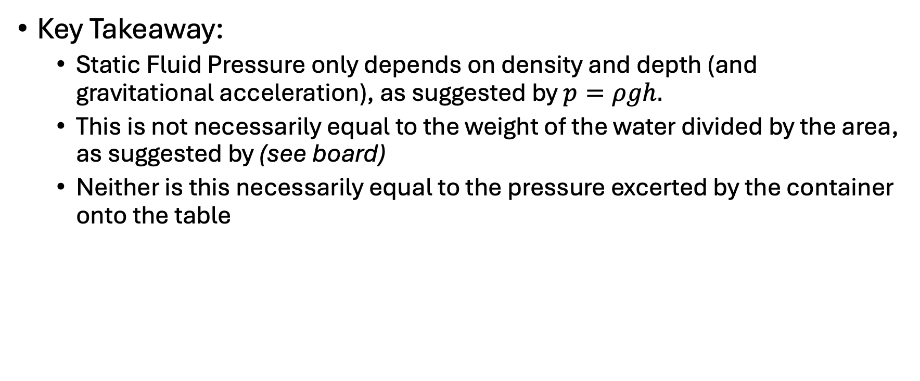
Qu. 1
Key Takeaway:
Static Fluid Pressure only depends on density and depth (and gravitational acceleration), as suggested by $p=ρgh.$
This is not necessarily equal to the weight of the water divided by the area, as suggested by (see board)
Neither is this necessarily equal to the pressure excerted by the container onto the table

Slide 8
Qu. 1
Some more:
Pascal’s Principle: a pressure change at any point in a confined incompressible fluid is transmitted throughout the fluid such that the same change occurs everywhere
Fluid pressure is transmitted, not force.
Pistons (see board)

Slide 9
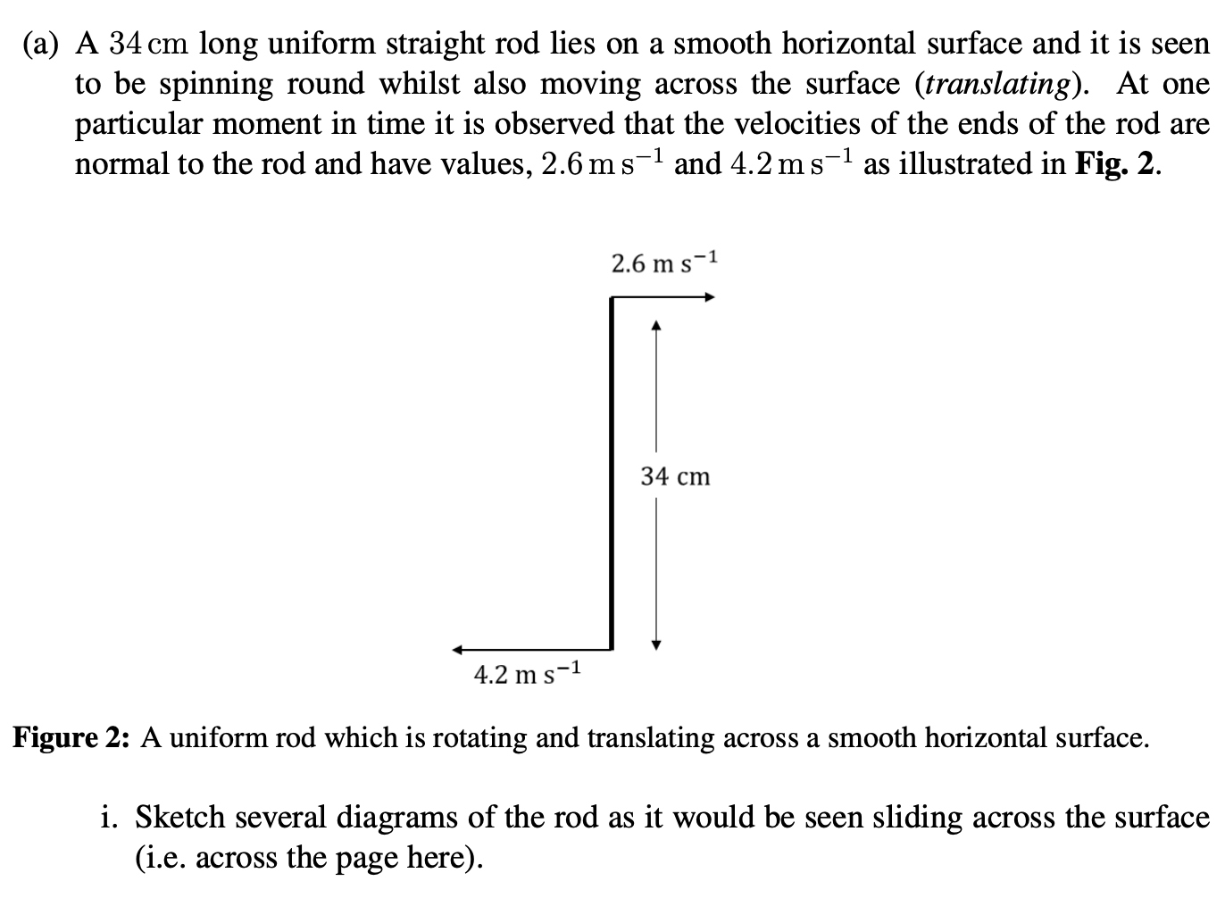
Qu. 2 (Time: 2 min)

Slide 10
Qu. 2
Key Takeaway:
Principle of Dynamics in Centre of Mass: a mass system’s centre of mass experiences acceleration according to N2, where the resultant force is equal to the resultant of all forces added to the system. (Proof omitted.)
Principle of Decomposing Motion: an object’s motion can always be separated into two parts: translation and rotation.
Translation and rotation can both be represented as vectors. (Think: how should rotation be represented as a vector, in generalization to 3D space?)
Rotational Mechanics will be left to a later session

Slide 11
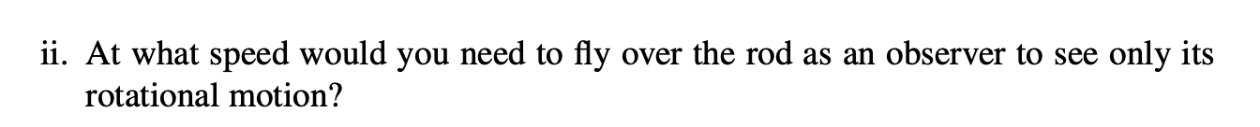
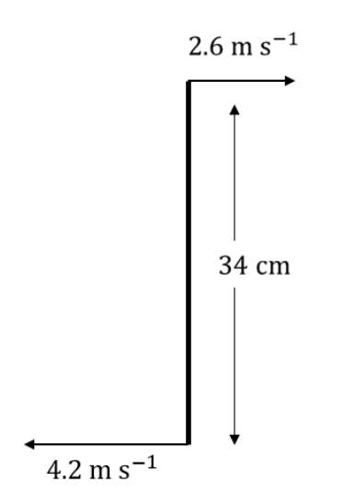
Qu. 2 (Time: 1 min)

Slide 12

Qu. 2 (Time: 1.5 min)

Slide 13
Qu. 2
Key Takeaway:
Every object is in motion
We choose to describe objects in a reference frame
It will make our life easier if we describe it in the correct reference frame (which requires experience)
Some more:
Reference frames: inertial and non-inertial

Slide 14
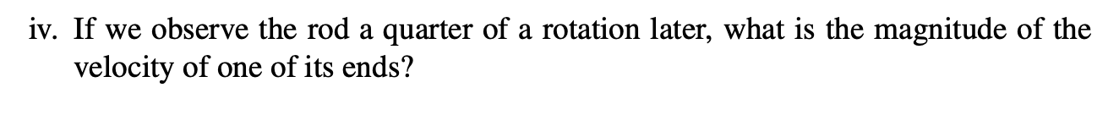
Qu. 2 (Time: 2 min)

Slide 15
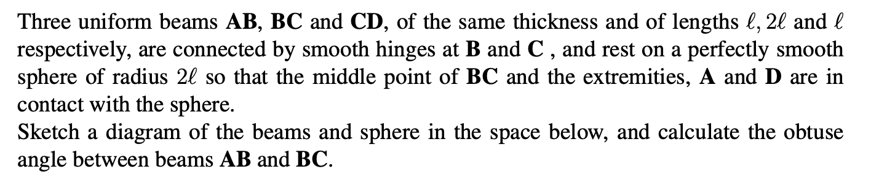
Qu. 3 (Time: 2 min)
Skipped

Slide 16
Qu. 3
Key Takeaway:
Have a rule, a pencil and a rubber (essential)
Have a pencil sharpener (very important)
Have a calculator (and make sure it has a correct set-up)
Have a protractor and set squares (highly recommended)
Draw a diagram
Geometry & trigonometry is important
Mathematical Methods will be covered in a later session
Skipped

Slide 17
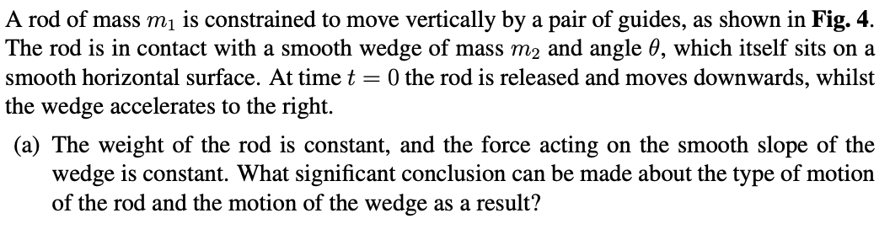
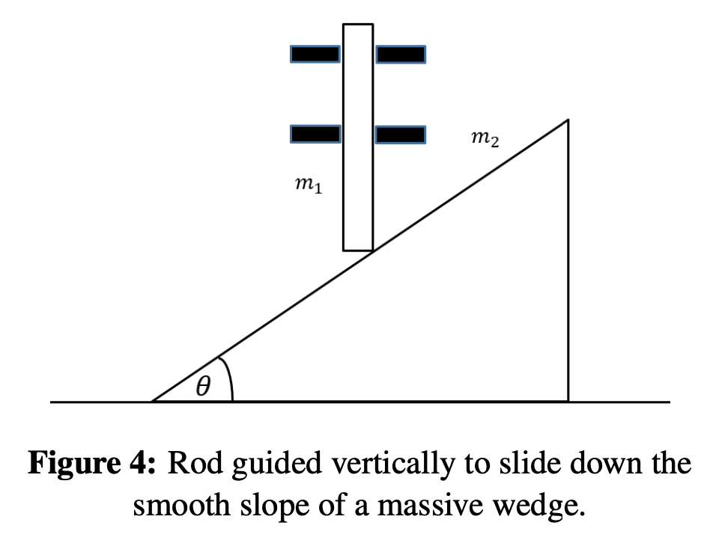
Qu. 4

Slide 18
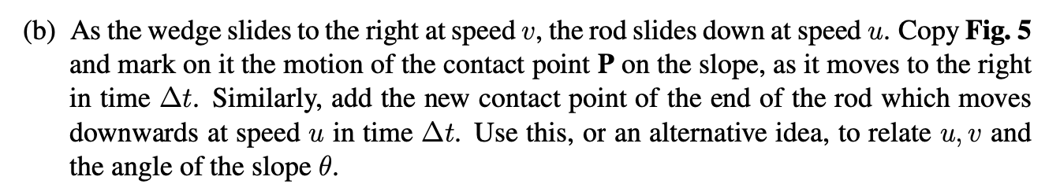
Qu. 4
Draw your own Fig. 5

Slide 19
Qu. 4
Key Takeaways:
Infinitesimal Analysis is a nice ‘non-mathematical’ trick in Physics
Essentially, if you cannot imagine big processes, imagine small processes in a short period of time and try to see what you can get from that.
Draw a diagram & trigonometry is important

Slide 20
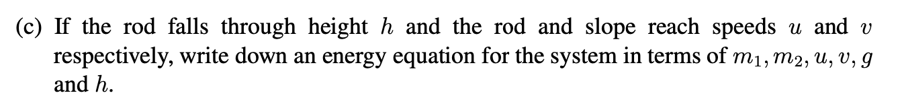
Qu. 4

Slide 21
Qu. 4
Key Takeaways:
Be brave to set up equations with variables
Every ‘link’ is an equation – this reduces the freedom that the system of equations has
If you want to solve the equation, you need to have the same number of variables as the number of equations (some linear algebra)
If the question is numerical – use your calculator!
Grasp an idea of ‘restricting degree of freedom'

Slide 22
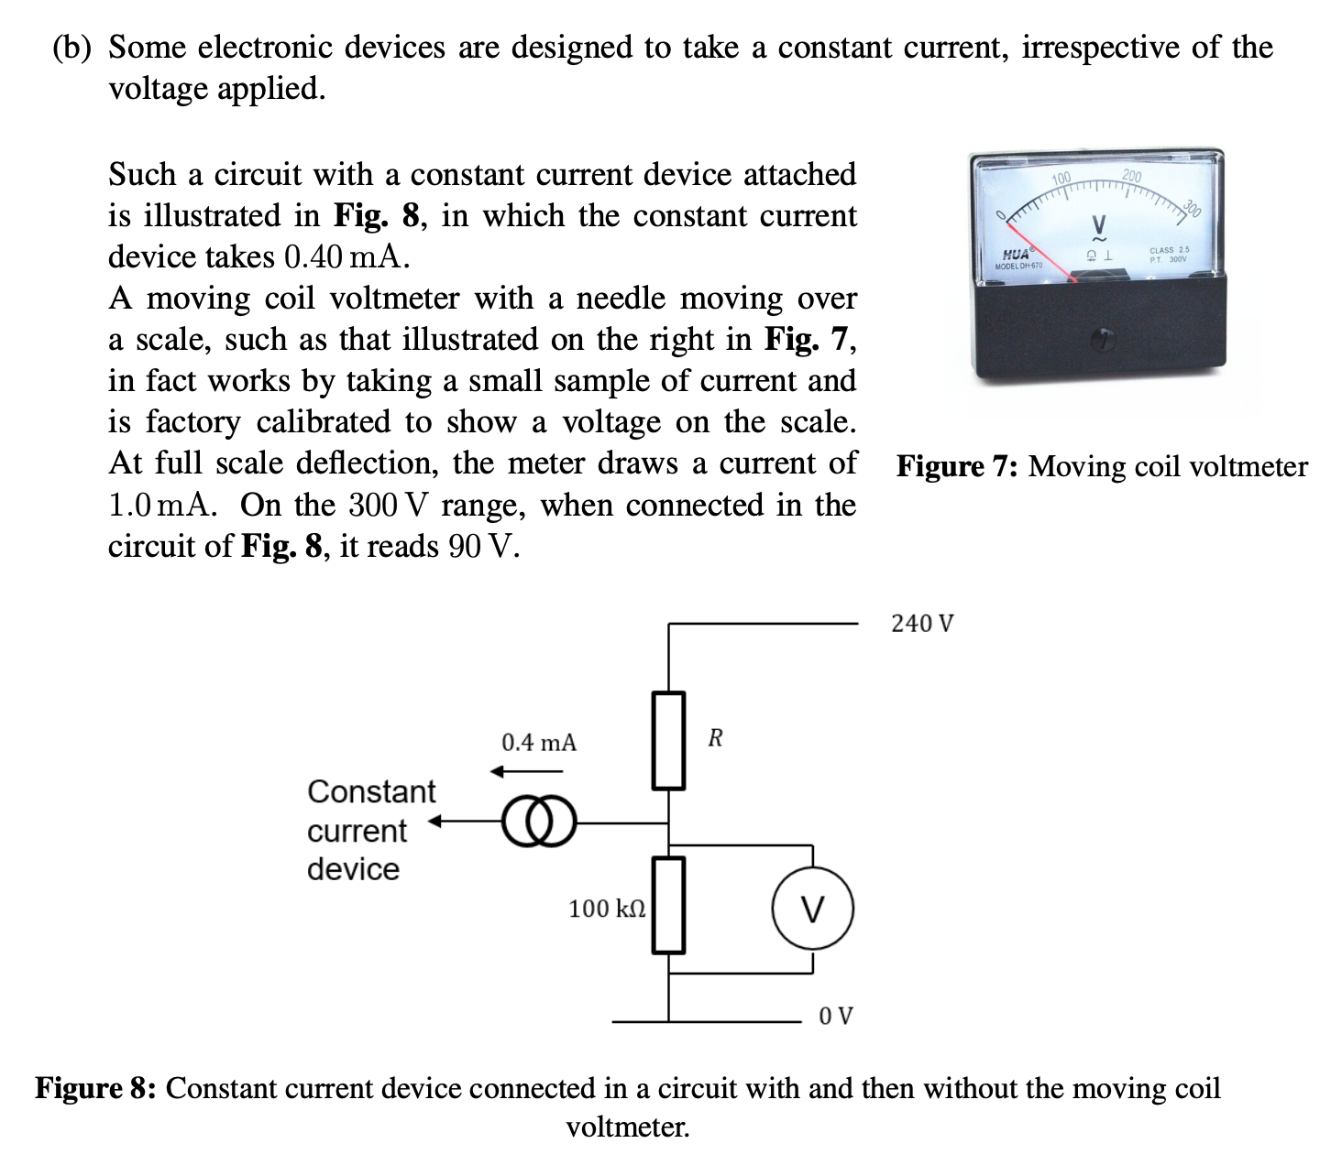
Qu. 5
Skipped

Slide 23
Qu. 5
Key takeaways:
Voltmeter can be ‘deleted’ – but in real life they are just extremely big resistors
Ammeter can be replaced by a wire – but in real life they are just extremely small resistors
Circuit analysis techniques will be covered later in a topic-specific session.
Skipped

Slide 24
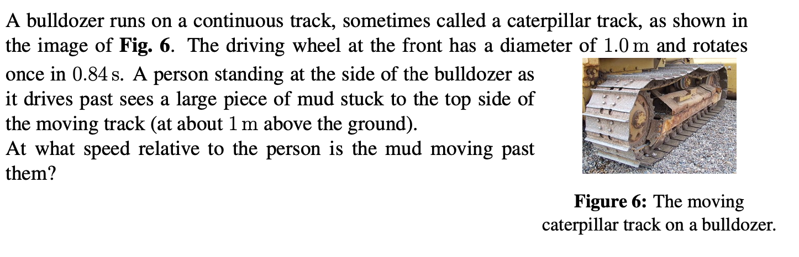
Qu. 6 (Time: 4 min)
Skipped

Slide 25
Qu. 6
Key Takeaways:
Draw a diagram
Motion is relative
Skipped

Slide 26


Remaining Questions
Questions are from 2023 SPC (with different numbering)
Remaining are:
Qu. 1, 3, 4 (MC)
Qu. 5 (b), 6 (e) (Mechanics)
Qu. 9 (a) (Electricity)
Qu. 10
Qu. 6 is also strongly recommended to have a taste of
Feel free to write up attempts (no scribbling!) to questions and submit a Google Classroom assignment before Friday 16:15 if you want to have it marked & individual feedback.
Also:
Qu. 7, 8, 9 (b)
are skipped

Slide 27
Next Time
Cool-down session discussing SPC
(And more TBC) – Now confirmed: Interesting Problems in Physics

